Slide 1
Retail Chain Forecast
Sales demand forecasting and customer intelligence for a ten-store Kenyan supermarket chain
Notes:
Introduce the project: forecasting and customer analysis for a ten-store Kenyan supermarket chain. The data is synthetic (AI-generated), so every step is documented and reproducible. The question driving everything: can we forecast demand well enough to stock without waste or stock-outs?

Slide 2
The problem and how success was measured
The problem
A supermarket chain must stock enough of each product without waste (perishables) or empty shelves (stock-outs).
Core Business Questions
How much revenue, how many units and how many receipts will each store and product sell over the next weeks and month?
How much extra do promotions sell, does a deeper discount sell more, and do sales dip after a promotion ends?
Do inflation, public holidays and payday make the forecast more accurate?
How success was measured
Target: a WAPE of 15% or less on unseen data, always compared with a “same as last period” baseline.
WAPE replaced MAPE: rows with zero sales make MAPE undefined or huge, and small products dominate it.
Forecasts are per store and product.
Notes:
The three core questions come from the problem framing: forecasting, promotional impact, and whether inflation, holidays and payday help. Supporting analysis covers stores, customers and retention. Success was a WAPE of 15 percent or less on the test set, always against a same-as-last-period baseline. WAPE replaced MAPE because zero-sales rows break MAPE. Be ready to say the target was met only for some results, which a later slide shows.

Slide 3
Datasets and approach
Table | Content | Rows
branches | ten stores | 10
products | catalogue with tiers and prices | 171
customers | registered customers | 8,222
promotions | promotion calendar | 322
transactions | receipts, including returns | 435,951
receipt lines | items on each receipt | 2,175,508
inflation | 12-month inflation, KNBS (real) | 24 months
holidays | Kenyan public holidays (real) | 27 dates
Approach
Generate and clean the data
Explore it and test the effects
Analyse it in SQL (PostgreSQL)
Forecast weekly and monthly demand
Present it in a Power BI dashboard
Document and package the repository
Notes:
Ten stores, 171 products, 8,222 registered customers, about 436 thousand receipts and about 2.2 million receipt lines over two years. Everything is synthetic except the inflation series (KNBS, via the Central Bank of Kenya) and the public holidays (Kenyan law and Gazette notices). Sales exclude returns, so the dashboard shows about 431 thousand sales transactions against 435,951 raw receipts.

Slide 4
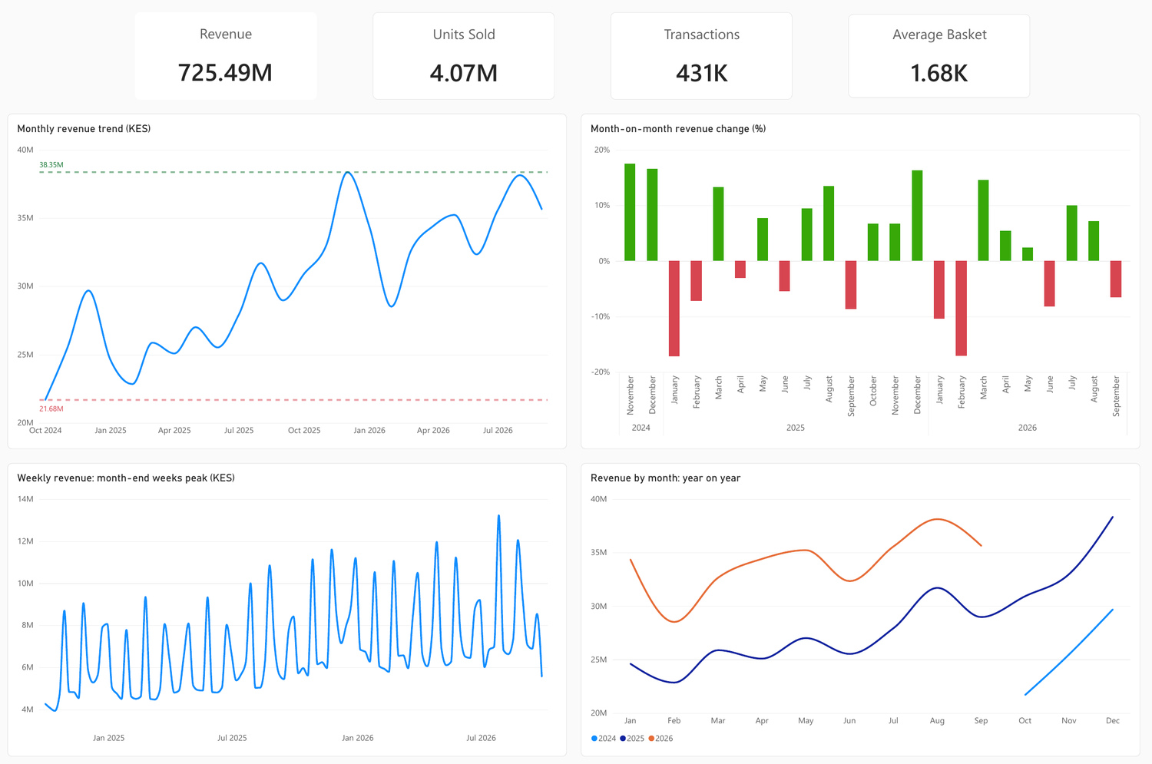
Sales grow, and every month-end peaks
KES 725.5M
total revenue
431K
transactions, returns excluded
KES 1.7K
average basket
Best month: December 2025 (KES 38.4M). Deepest dip: February 2026 (about KES 28.5M). Month-end weeks reach KES 9-13M against 6-7M in ordinary weeks.
Notes:
Revenue totals KES 725.5 million across 431 thousand sales transactions, an average basket of about KES 1.7 thousand. Monthly revenue rose from about 21.7 million in October 2024 to about 35.6 million in September 2026. The pattern repeats every year: strong December, a January and February drop, a March rebound. Within each month the last week is the peak (payday), which drives the forecast later.

Slide 5
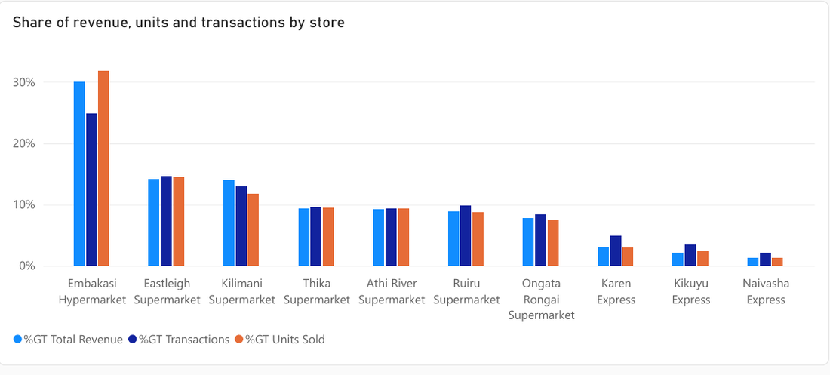
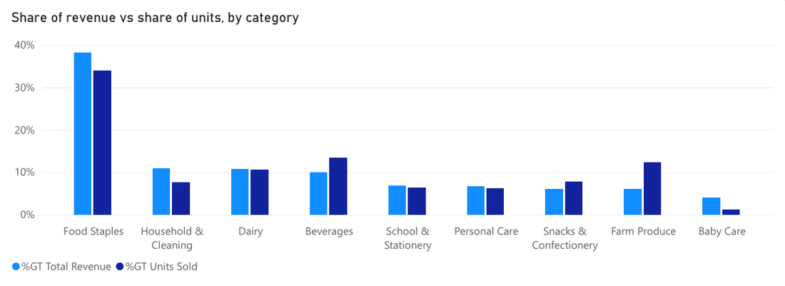
A few stores and staples carry the sales
29.9%
about 38%
6% vs 12%
of revenue from Embakasi Hypermarket; Naivasha Express earns the least (1.3%)
of revenue from Food Staples; Standard products earn the most in every store
Farm Produce share of revenue against its share of units: high volume, low value, perishable
Notes:
Embakasi Hypermarket earns almost 30 percent of revenue; the three largest stores earn about 58 percent. Standard-tier products earn the most revenue in every store. Food Staples are about 38 percent of revenue. For stocking, Farm Produce matters: about 6 percent of revenue but about 12 percent of units, so it is high volume, low value and perishable, which means waste risk.

Slide 6
Month-end improves sales, inflation does not
1.9×
Month-end days bring in about 1.9 times an ordinary day’s revenue.
+44%
Saturday averages KES 1.25M a day against 0.87M on Monday: weekends are strongest.
21%
of revenue comes from discounted lines, mostly at 1-20% discounts; removing the planned discount makes weekly forecasts 2 - 4 points worse.
No effect
Public holidays look like ordinary days, and inflation shows no link to revenue.
Notes:
Month-end days average about KES 1.65 million a day against 0.87 million on ordinary days. Weekends beat weekdays. About a fifth of revenue comes from discounted lines, and the forecast test later shows that the planned discount improves accuracy by 2 to 4 points. Public holidays are no different from ordinary days, and inflation, which moved between 3.7 and 5.7 percent, shows no consistent link to revenue. The statistical tests behind the promotion and calendar claims are in the exploratory notebook.

Slide 7
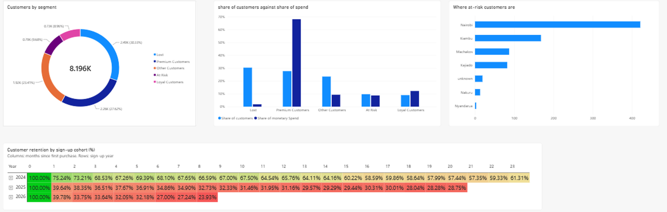
Value is concentrated; new customers leave
68%
793
40% vs 75%
of spend comes from the 28% of customers who are Premium
customers (9.7%) are At Risk, mostly in Nairobi and Kiambu
return after one month: 2025–26 sign-ups against the 2024 group
Notes:
Customers are segmented with RFM scores in SQL. Premium customers are 28 percent of the 8,196 customers who bought but about 68 percent of spend. 793 customers are At Risk: they used to buy often but have gone quiet, and most are in Nairobi and Kiambu. Cohort retention shows the 2024 sign-ups still around 61 percent active after almost two years, while 2025 and 2026 sign-ups return at about 40 percent after one month. About half of all transactions carry no customer ID, so this covers registered customers only. Lost customers are 30 percent of the base but only about 2 percent of spend, and about 79 percent of one month's customers buy again the next month.

Slide 8
How the forecast was built
Train: 70%
Validation: 15%
Test: 15%
The models learn from these periods
Used to compare models and features
Used once, for the final scores
A chronological split, because it is a forecast/prediction model. Weekly: 71 / 15 / 16 weeks. Monthly: 16 / 3 / 4 months.
Features
Models
Scoring
Month, payday days, holiday flag, planned discount, inflation, store, product and category codes, last period’s sales and the recent average.
Gradient boosting and random forest, one model per target (revenue, units, transactions), compared with a baseline that repeats last period’s sales.
WAPE (total error as a % of total sales), plus MAE and R². MAPE was rejected because zero-sales rows break it.
Notes:
Each row is one store, one product and one week (or month), with complete periods only and zero-sales periods filled in. The split is by time: train on the first 70 percent, choose models and features on the next 15, and use the last 15 percent once for the final scores. Past-sales features use only earlier periods. WAPE adds up all the errors and divides by total sales, so zero-sales rows do not break it the way they break MAPE. The baseline simply repeats the previous period.

Slide 9
Both models beat the baseline
Notes:
These are the final scores on the test set. Weekly revenue error falls from 47.1 percent for the baseline to 30.4 percent with gradient boosting; monthly from 24.9 to 20.3. The 15 percent target was met only for monthly transactions at store and product level; added up across the whole chain, weekly revenue is within about 5 percent. The random forest is slightly better for some monthly targets and slightly worse for others, with differences of about a point, so I chose gradient boosting because it is more accurate weekly and trains in seconds rather than minutes. Monthly results rest on only four test months. Monthly error is lower than weekly because adding up a month smooths out week-to-week noise; the two levels should not be compared as better or worse.

Slide 10
Payday and promotions improve model accuracy
Payday timing and promotions help
Removing them makes weekly revenue error 3.6 and 2.4 points worse.
Holidays and inflation add nothing
Removing either changes the error by 0.1 points or less.
Inflation cannot be tested well here
Two years of slow-moving data. Monthly, removing it even improved revenue error by about 3 points, on only 3 validation months.
Weekly revenue, validation set. A positive number means the model is worse without that feature.
Notes:
To find out what the model actually uses, I retrained it with each feature group removed and compared the validation error. Removing payday days raised weekly revenue error by 3.6 points and removing the promotion discount by 2.4. Removing holidays or inflation changed it by 0.1 or less. With all four removed the error rose by 7.5 points. Inflation changes slowly over two years, so it can act as a stand-in for the date, and this test cannot show whether it matters in reality. This also fits the exploration: month-end and promotions mattered there, holidays did not.

Slide 11
Where the forecast falls short
12-15%
under-forecast of the biggest peak (week of 27 July)
5% vs 30%
error of weekly totals against error per store and product
-14.5%
School & Stationery units under-forecast; Ball Pens and Exercise Books are the worst products
Test period, approximate values. Negative = under-forecast (stock-out risk);
positive = over-forecast (overstock risk).
Notes:
The forecast is close in total, with about 5 percent error on weekly totals, but much looser for individual products at about 30 percent. It underpredicts the largest month-end peak, in the week of 27 July, by 12 to 15 percent. By category it runs low for School & Stationery, Beverages and Farm Produce, which means stock-out risk, and high for Personal Care, which means overstock risk. The worst individual products are Ball Pens, Exercise Books and Tomatoes. The category values on this chart are read from the dashboard, so they are approximate.

Slide 12
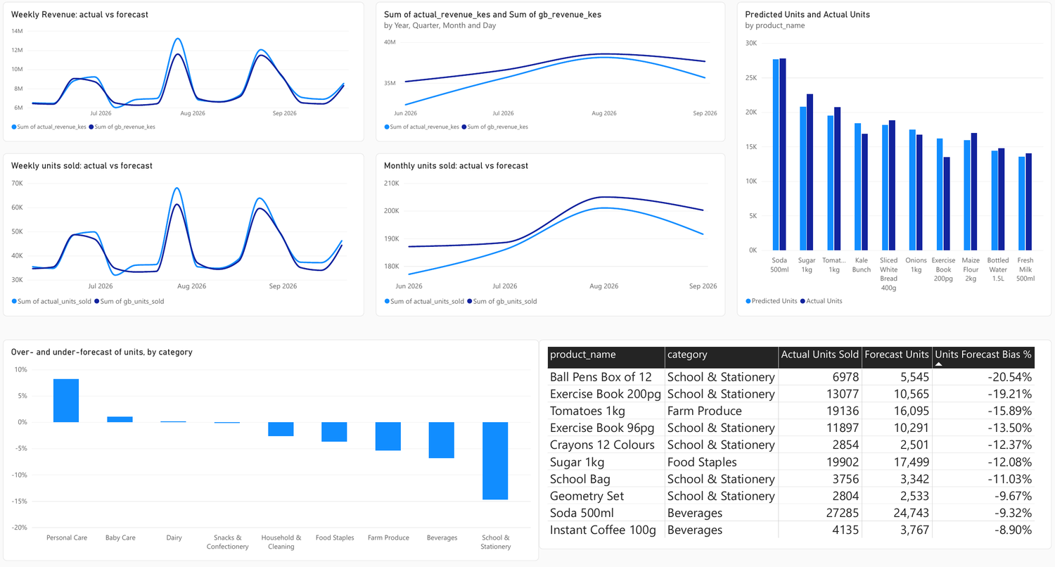
The dashboard: five pages, one question each
Page | Question it answers
1. Sales Overview | How is the business performing, and when do sales peak?
2. Stores & Products | Which stores, categories and products drive sales?
3. Promotions & Calendar | What lifts sales, and does inflation matter?
4. Customers | Who is valuable, who is at risk, and do customers come back?
5. Forecast & Stocking | How accurate is the forecast, and can it guide stock levels?
Page 5, Forecast & Stocking (test period only)
Built in Power BI from the SQL views and tables and the two prediction files, linked on store, product and date, with slicers on every page.
Notes:
The dashboard has five pages and each answers one question. Pages 1 to 3 use the full sales history; page 4 uses the SQL views for RFM segments and cohort retention; page 5 uses the prediction files from the model notebook and covers the test period only. Slicers filter the pages where they apply. The WAPE shown on page 5 (30.43 percent weekly revenue, 20.35 percent monthly) matches the model notebook.

Slide 13
Reproducing the work
How to run it
Create the environment from environment.yml
Generate the data with generate_data.py (seed 42) and add the two external files
Run the notebooks in order: cleaning, exploration and tests, model
Run retail_analysis.sql in PostgreSQL for tables, queries and views
Open the dashboard screenshots, or rebuild the Power BI file from the views and predictions
How it was checked
Chronological split; the test set was used once, after every choice was made on validation
Every model compared with a same-as-last-period baseline
Dashboard figures match the notebooks (weekly revenue WAPE 30.43% in Power BI, 30.4% in the notebook)
Regenerated data gives similar numbers
Notes:
The repository has a README with the run order, an environment file, the generator script, numbered notebooks, the SQL file and dashboard screenshots. The data is synthetic and AI-generated, and the README says plainly that regenerating it gives similar but not identical results. Testing: a chronological split with the test set used once, a baseline for every model, and a cross-check that the dashboard KPIs match the notebooks.

Slide 14
Limitations to keep in mind
The data is synthetic and covers two years, so each seasonal pattern appears once or twice.
Inflation moves slowly, so its effect cannot be properly tested in this period.
The monthly validation (3 months) and test (4 months) sets are very short, so monthly results are rough.
The models underpredict the largest month-end peaks and some categories.
About half of transactions carry no customer ID, so customer analysis covers registered customers only.
The data has no stock or waste records, so the business benefit is not measured, and the dashboard forecasts cover only test period.
Notes:
Be upfront about what this can and cannot show. The data is synthetic and only two years long. Inflation cannot be properly tested over that span. The monthly validation and test sets are very short. About half of the transactions are anonymous walk-ins with no customer ID. The data has no stock or waste records, so the benefit in fewer stock-outs and less waste is not measured, and the dashboard forecasts are for the test period rather than future weeks.

Slide 15
What the business should do
1. Plan for month-end
Staff and stock for the last week of each month, when sales reach KES 9-13M against 6-7M.
2. Buy by category
Use the monthly forecast for purchasing (about 18-20% error for revenue and units) and add a buffer for School & Stationery.
3. Order perishables small and often
Farm Produce is 6% of revenue but 12% of units, so it carries the most waste risk.
4. Share the promotion calendar
Planned promotions improved forecast accuracy by 2–4 points, so feed them into the forecast.
5. Win back at-risk customers
793 customers have gone quiet; start with the biggest spenders in Nairobi and Kiambu.
6. Improve first purchases and ID capture
New customers return at about 40% against 75%, and about half of transactions carry no customer ID.
Notes:
Close with actions. Month-end planning and category-level buying use the forecast directly. Perishables and School & Stationery need different handling because of waste and stock-out risk. Sharing the promotion calendar with the forecast is supported by the feature test. For customers, win back the at-risk group and fix the first-purchase experience, and start capturing customer IDs at the till so future analysis covers more of the sales.

